Slide 1
Chapter 1
Computer sciences
أعداد:م.م. أحمد عبد الإله العاشور
كلية الصيدلة-جامعة البصرة

Slide 2
Computer Perform Three Mean Operations: -
1. Receive Input Data.
2. Process Data.
3. Produce Output. (Information which is meaningful data)

Slide 3
Computer System :-
The components of computer system are: -
1. Hardware:refers to physical part of computer such as (screen, mouse, keyboard, and system box).
2. Software: A set of instructions that tell the computer what to do and how to do it, such as: Word processing, computer games, & Graphics programs.
3. Users:A person who uses the software on the computer to do some tasks.

Slide 4
information technology
Information technology (IT) A set of tools that are used to: Receive process, store, print and transmit
information in an electrical form through computers. like:text, sound, picture or video.

Slide 5
Types of Computers
The four basic types of computers are as under:
1.Supercomputer
2.Mainframe Computer
3.Minicomputer
4.Microcomputer

Slide 6
1. Super Computer

Slide 7
2. Mainframe Computer

Slide 8
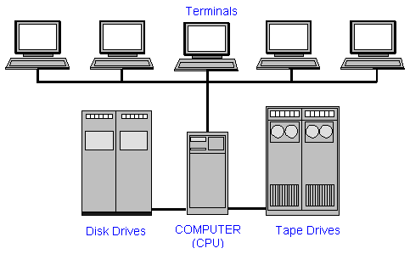
3. Minicomputer :(Midrange computers)

Slide 9
4. Microcomputer

Slide 10
Major Parts of the Computer
The computer consists of 7 main parts:
1-Motherboard
2-CPU
3-RAM(Random-access memory)
4-Hard Drive
5-Optical Drive or CD Drive
6-Video Card
7-Power Supply

Slide 11
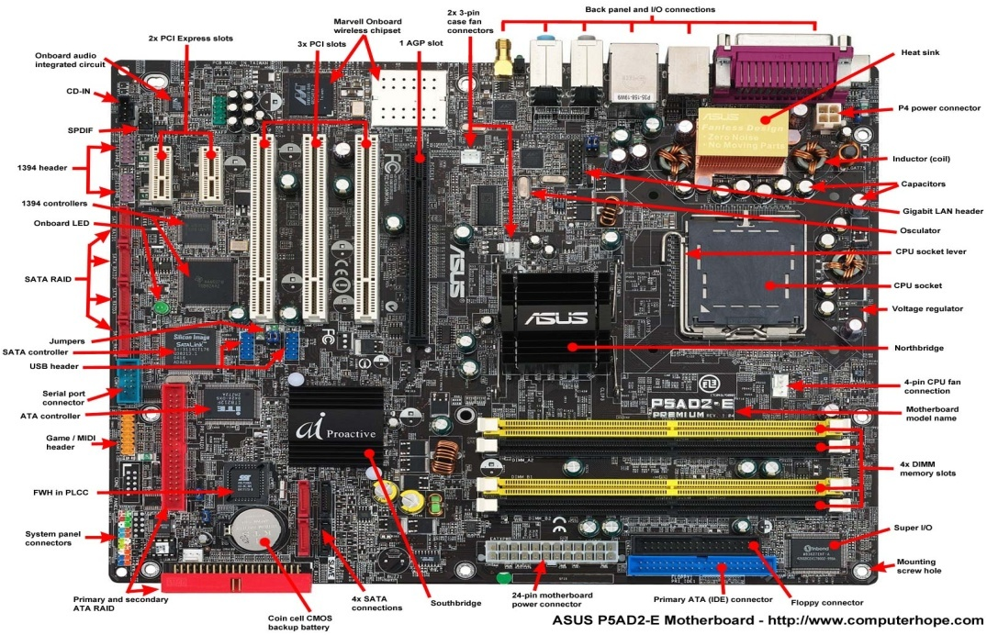
1-Motherboard
A motherboard ( the main board logic board) is the main printed circuit board (PCB) found in general purpose microcomputers and other expandable systems.

Slide 12
2-CPU(central processing unit)
A central processing unit (CPU) is the electronic circuitry within a computer that carries out the instructions of a computer program by performing the basic arithmetic, logical, control and input/output (I/O) operations specified by the instructions.

Slide 13
3-RAM(Random-access memory)
Is a form of computer data storage which stores frequently used program instructions to increase the general speed of a system

Slide 14
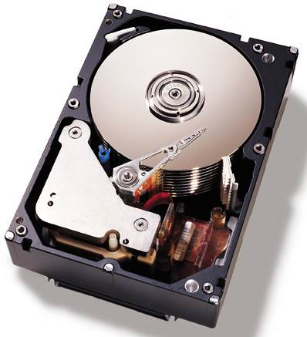
4-Hard Drive
A hard disk drive (HDD), hard disk, hard drive or fixed disk is a data storage device that uses magnetic storage to store and retrieve digital information using one or more rigid rapidly rotating disks (platters) coated with magnetic material.

Slide 15
5-Optical Drive or CD Drive
In computing, is a disk drive that uses laser light or electromagnetic waves within or near the visible light spectrum as part of the process of reading or writing data to or from optical discs.

Slide 16
6-Video Card
A video card (also called a display card, graphics card, display adapter or graphics adapter) is an expansion card which generates a feed of output images to a display (such as a computer monitor).

Slide 17
7-Power Supply
Also called a power supply unit or PSU, the component that supplies power to a computer.

